Slide 1

LAPTOP PRICE PREDICTION Using machine learning

Slide 2
Introduction: -
The laptop price predictor project is a very interesting project that you can use to predict the price of laptops. This will help you in saving money and time, because you don’t need to go to different stores and check prices every time you want to buy a new laptop.
The project will be divided into 3 parts, each having its own specific tasks. The first part is to create a model that predicts the price of laptops based on various factors such as the size of screen and CPU speed.
The second part is to test this model on real data collected from different websites. Finally, we test our model on new data sets to see if it can accurately predict how much a laptop costs.

Slide 3
Data Collection and Pre-processing: -
To collect and preprocess US tornado data, you can follow these general steps:
Data Collection
Data source:
There are various sources of Laptop Price Prediction. The data used in this paper is taken from Kaggle website.
Access the data:
Visit the websites of the selected sources to directly access the tornado datasets.
Download & Understand the data format:
The data was downloaded in CSV format to perform analyzations.

Slide 4
Data Preprocessing:
Import the data:
The downloaded Laptop Price Prediction data or programming environment, such as Python with libraries like Pandas, Numpy, Matplotlib, Seaborn, Scikit etc.
Data cleaning & transformation:
Checked for missing values, inconsistencies, or errors in the dataset. Fortunately they were no missing values in dataset, Had to drop the date columns as I was able to generate information using the Month, Inche and price column. I had to apply label encoding for states to convert the feature to numeric from categorical. Machine Learning Only consider numeric values so I had to convert the feature (company,TypeName,ScreenResolution,Cpu,ram,memory,Gpu,OpSys,Weight) type to Integer from object and float
Feature engineering:
While performing EDA I created a new data frame for understanding
Company of laptop price based on width ,inches and price.
Save the preprocessed data:
Store the cleaned and processed Laptop price prediction data in a suitable format for future analysis, such as CSV or a database.

Slide 5
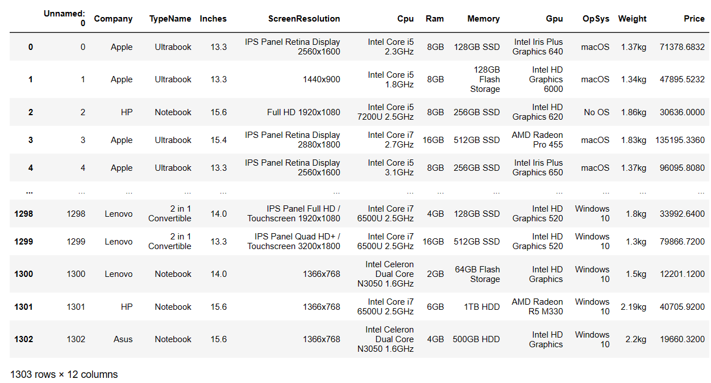
Laptop price prediction dataset :-

Slide 6
Flow of design and analysis
Algorithms flowchart

Slide 7
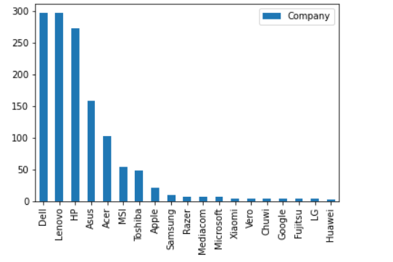
Explanatory Data Analysis (EDA):-
Exploratory Data Analysis (EDA) is one of the techniques used for extracting vital features and trends used by machine learning and deep learning models in Data Science.
Here’s an illustration of plotting a barplot for the feature TypeName (type of laptop)

Slide 8
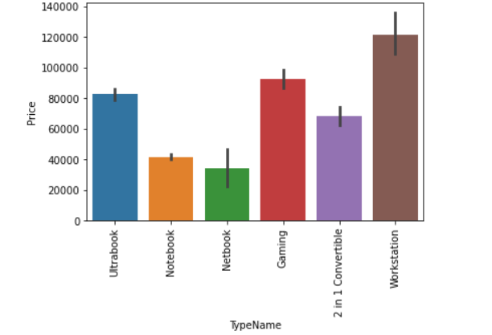
Data Visualisation using barplot

Slide 9
Linear Regression
Algorithm:
Linear regression is the algorithm that aims to find the best-fitting line that represents the relationship between the input features and the target variable. The algorithm estimates the coefficients (slope and intercept) of the line that minimize the difference between the predicted values and the actual target values.
Model training:
The training process involves fitting the linear regression model to the training data, estimating the optimal values for the coefficients ('m' and 'b'). This is typically done using numerical optimization methods such as Ordinary Least Squares (OLS) or gradient descent
Model evaluation:
After training, the model's performance is assessed using evaluation metrics such as Mean Squared Error (MSE) = 1.14, Root Mean Squared Error (RMSE), or R-squared = 0.65 . These metrics quantify the discrepancy between predicted and actual values, providing insights into the model's accuracy and predictive power.

Slide 10
Results and Analysis
Apart from linear regression I have also used Decision Tree Regressor, Random Forest Regressor, KNN further.
Linear Regression Mean Squared Error : 1.14 and R^2 Score = 0.65
Decision Tree Regressor :
The Decision Tree Regressor is a machine learning algorithm used for regression tasks. It is a predictive model that maps features of an input to a continuous target variable
Decision Tree Regressor Accuracy Score =96.2 %
Random Forest Regressor :
The Random Forest Regressor is an ensemble learning algorithm used for regression tasks. It is an extension of the decision tree algorithm that combines multiple decision trees to make predictions.
Random Forest Regressor Accuracy Score For Training Data = 97.6%
Random Forest Regressor Accuracy Score For Test Data = 97.7%
Random Forest Regressor R^2 SCORE = 0.66
K NEAREST NEIGHBOR (KNN) :
K-Nearest Neighbors (KNN) Regressor is a machine learning algorithm used for regression tasks. Unlike parametric models, KNN is a non-parametric algorithm that makes predictions based on the similarity of data points in the feature space.
K NEAREST NEIGHBOR (KNN) MSE= 1.95 & R^2 Score = 0.41

Slide 11
Conclusions :-
Predicting something through the application of machine learning using the Decision Tree algorithm makes it easy for students, especially in determining the choice of laptop specifications that are most desirable for students to meet student needs and in accordance with the purchasing power of students. Students no longer need to look for various sources to find laptop specifications that are needed by students in meeting the needs of students, because the laptop specifications from the results of the machine learning application have provided the most desirable specifications with their prices of laptops.

Slide 12
References:-
https://www.kaggle.com/code/danielbethell/la ptop-prices-prediction
Google
YouTube

